Slide 1

social media social media Social media
Lecture 8
Noreen Shah

Slide 2
Writing Strategies for Social Media
Social media have changed the relationship between sender and receiver, so the nature of the messages needs to change as well. Whether you’re writing a blog or posting a product demonstration video to YouTube, consider these tips for creating successful content for social media:
Remember that it’s a conversation, not a lecture or a sales pitch.
Write informally but not carelessly.
Create concise, specific, and informative headlines.
Get involved and stay involved.
If you need to promote something, do so indirectly.
Think before you post!

Slide 3
Social networks
Public, general-purpose networks. Facebook and Google+ are the largest and best known of these networks.
Public, specialized networks. Whereas Facebook and Google+ serve a wide variety of personal and professional needs, other networks focus on a particular function or a particular audience. The most widely known is LinkedIn, with its emphasis on careerand sales-related networking.
Private networks. Some companies have built private social networks for internal use, either as standalone systems or as part of broader collaboration and communication systems. The Red Robin restaurant chain, for example, uses the Yammer social network to share information across the organization nationwide and up and down the corporate ladder.

Slide 4
BUSINESS COMMUNICATORS INNOVATING WITH SOCIAL MEDIA
Companies in virtually every industry use social media and continue to experiment with new ways to connect with customers and other stakeholders. From offering helpful tips on using products to helping customers meet each other, these companies show the enormous range of possibilities that new media continue to bring to business communication.

Slide 5
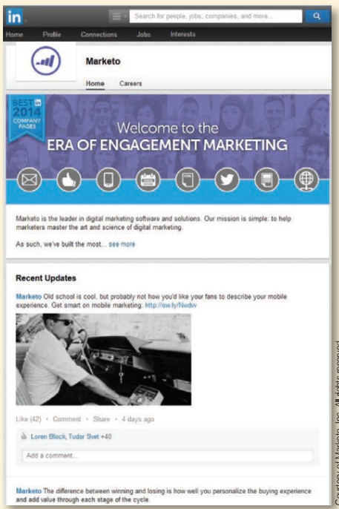
Recruiting and Business-Focused Social Networks
Marketo, a developer of digital marketing software, maintains a profile in LinkedIn, as do hundreds of its employees.

Slide 6

Tweetups
A powerful capability of online social media is bringing people with similar interests together offline. Tweetups, for example, are in-person meetings planned and organized over twitter.

Slide 7

Value-Added Content via Social Networks
Thousands of companies are on social networking platforms, but blatantly promotional posts are not always welcome by fans and followers. Instead, companies such as Whole Foods use social networks to share information of interest, such as recipes and nutritional advice.

Slide 8

Value-Added Content via Blogging
One of the best ways to become a valued member of a network is to provide content that is useful to others in the network. The Quizzle personal finance blog offers a steady stream of articles and advice that help people manage their finances.

Slide 9
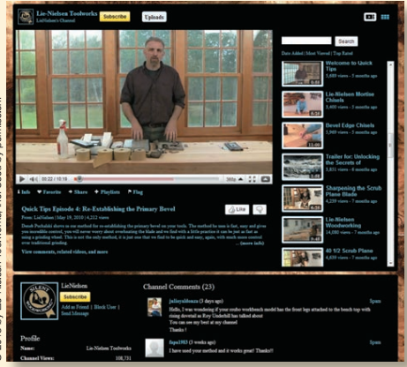
Value-Added Content via Online Video
Lie-Nielsen Toolworks of Warren, Maine, uses its YouTube channel to offer valuable information on choosing and using premium woodworking tools. By providing sought-after information for both current and potential customers free of charge, these videos help Lie-Nielsen foster relationships with the worldwide woodworking community and solidify its position as one of the leaders in this market. Animal Planet, Best Western, and Taco Bell are among the many other companies that make effective use of branded channels on YouTube.

Slide 10
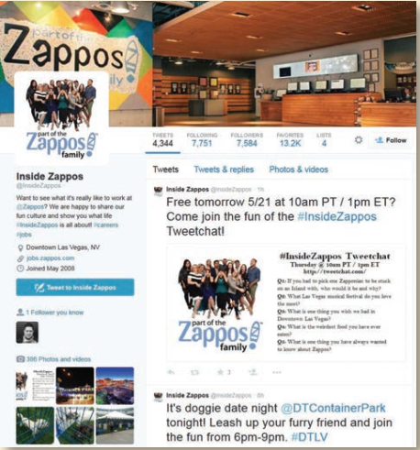
Employee Recruiting
Zappos is one of the many companies now using Twitter as a recruiting tool. The company’s @InsideZappos account gives potential employees an insider’s look at the company’s offbeat and upbeat culture.

Slide 11
Blogging
Blogs, online journals that are easier to personalize and update than conventional websites, are a major force in business communication. To maintain a positive connection with target audiences, business bloggers should follow several important guidelines:
Communicate with personal style and an authentic voice.
Deliver new information quickly.
Choose topics of peak interest to audiences.
Encourage audiences to join the conversation.

Slide 12
UnDERSTAnDIng ThE BUSInESS APPLICATIonS oF BLoggIng
The business applications of blogs include a wide range of internal and external communication tasks
● Anchoring the social media presence. As noted earlier, the multiple threads of any social media program should be anchored in a central hub that the company or an individual owns and controls. Blogs make an ideal social media hub.
● Project management and team communication. Using blogs is a good way to keep project teams up to date, particularly when team members are geographically dispersed.
● Internal company news. Companies can use blogs to keep employees informed about general business matters, from facility news to benefit updates. By reducing the need for grapevines to spring up, blogs can enhance communication across all levels of a company.
● Customer support. Customer support blogs answer questions, offer tips and advice, and inform customers about new products. Also, many companies monitor the blogosphere (and Twittersphere), looking for complaints and responding with offers to help dissatisfied customers.

Slide 13
UnDERSTAnDIng ThE BUSInESS APPLICATIonS oF BLoggIng
●● Public relations and media relations. Many company employees and executives now share company news with both the general public and journalists via their blogs.
●● Recruiting. Using a blog is a great way to let potential employees know more about your company, the people who work there, and the nature of the company culture. In the other direction, employers often find and evaluate the blogs and microblogs of prospective employees, making blogging a great way to build a name for yourself within your industry or profession.
●● Policy and issue discussions. Executive blogs in particular provide a public forum for discussing legislation, regulations, and other broad issues of interest to an organization.
●● Crisis communication. Using blogs is an efficient way to provide up-to-the-minute information during emergencies, to correct misinformation, or to respond to rumors.
●● Market research. Blogs are a clever mechanism for soliciting feedback from customers and experts in the marketplace. In addition to using their own blogs for research, today’s companies need to monitor blogs that are likely to discuss them, their executives, and their products. Negative product reviews, rumors, and other information can spread across the globe in a matter of hours, and managers need to know what the online community is saying—whether it’s positive or negative.
● Brainstorming. Online brainstorming via blogs offers a way for people to toss around ideas and build on each others’ contributions.
●● Employee engagement. Blogs can enhance communication across all levels of a company, giving senior managers a channel they can use to communicate with employees and giving employees the chance to offer comments and ask questions.

Slide 14
UnDERSTAnDIng ThE BUSInESS APPLICATIonS oF BLoggIng
●● Customer education. Blogs are a great way to help current and potential customers understand and use your products and services. Doing so can also improve sales and support productivity by reducing the need for one-on-one communication.
●● Word-of-mouth marketing. Bloggers and microbloggers often make a point of providing links to other blogs and websites that interest them, giving marketers a great opportunity to have their messages spread by enthusiasts. Word-of mouth marketing is often called viral marketing in reference to the transmission of messages in much the same way that biological viruses are transmitted from person to person. However, viral marketing is not really an accurate metaphor. As author Brian Solis puts it, “There is no such thing as viral marketing.” Real viruses spread from host to host on their own, whereas word-of-mouth marketing requires “hosts” to spread messages voluntarily. The distinction is critical because you need to give people a good reason—good content, in other words—to pass along your message.
●● Influencing traditional media news coverage. According to the social media consultant Tamar Weinberg, “The more prolific bloggers who provide valuable and consistent content are often considered experts in their subject matter” and are often called upon when journalists need insights into various topics.25
●● Community building. Blogging is a great way to connect people with similar interests, and popular bloggers often attract a community of readers who connect with one another through the commenting function.

Slide 15
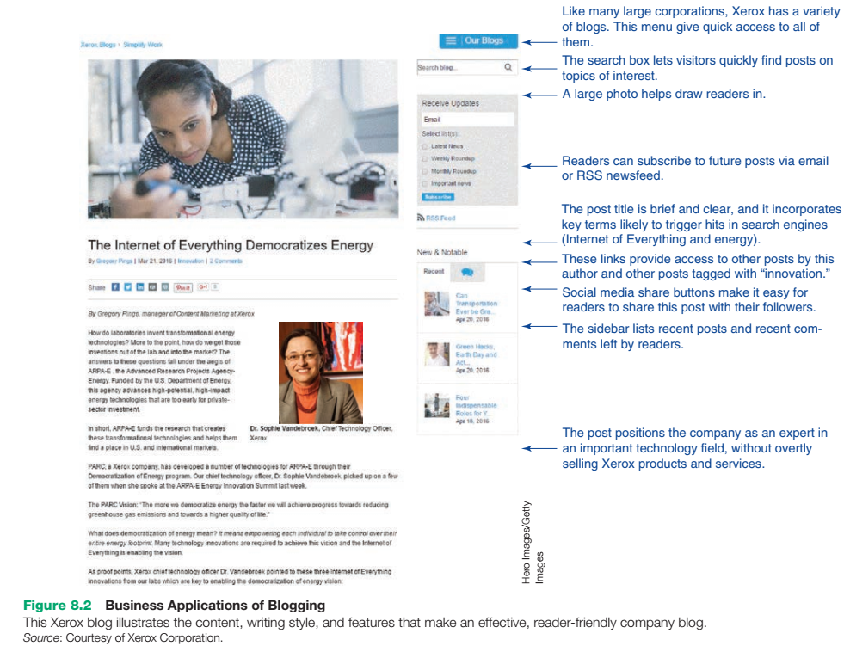

Slide 16
Microblogging
A microblog is a variation on blogging in which messages are sharply restricted to specific character counts. Twitter is the best known of these systems, but many others exist. Some companies have private microblogging systems for internal use only, either as standalone services or as part of broader collaboration systems.

Slide 17
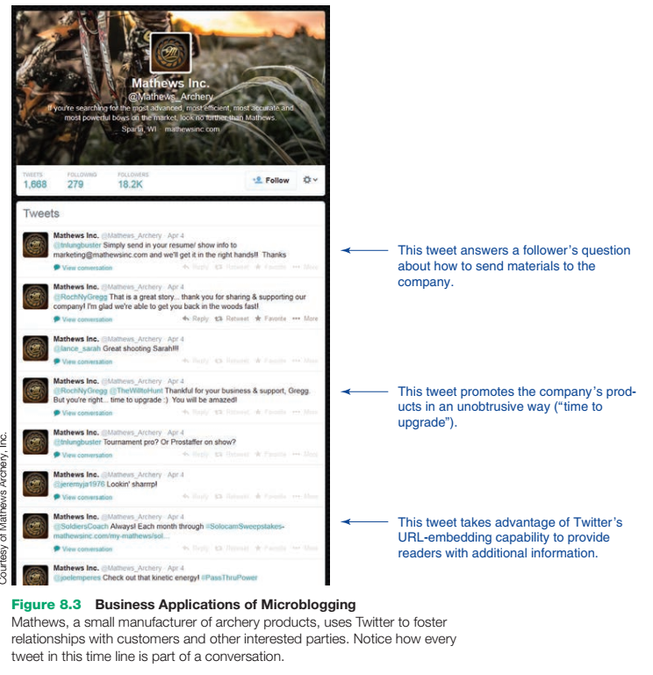

Slide 18
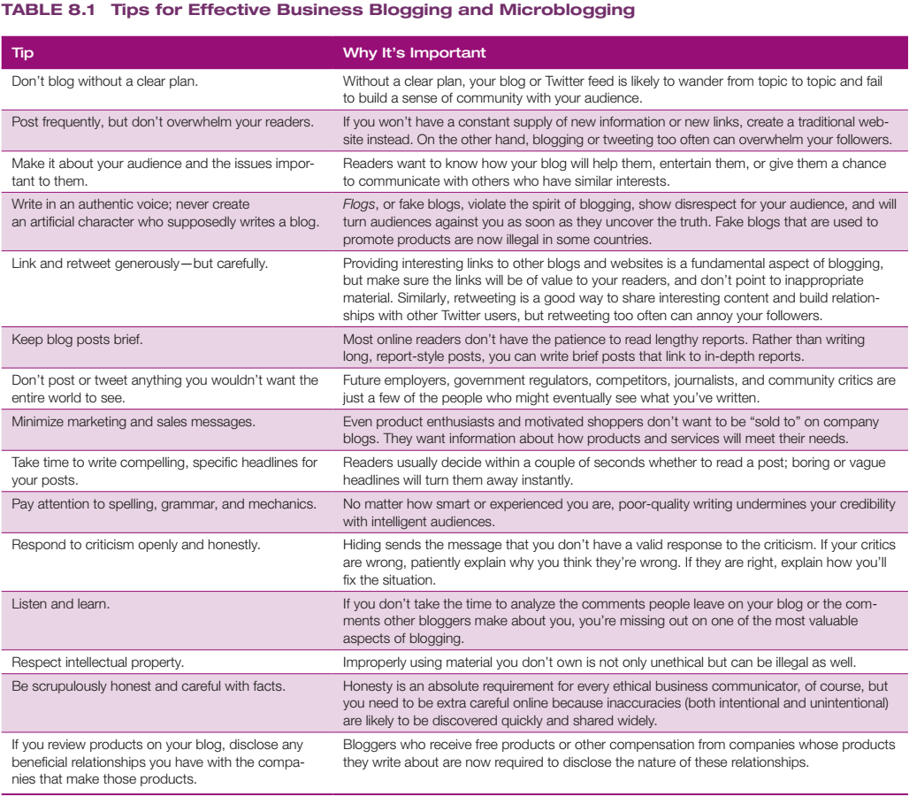

Slide 19
Wikis
Using wikis is a great way for teams and other groups to collaborate on writing projects, from brief articles to long reports and reference works. The benefits of wikis are compelling, but they do require a unique approach to writing.

Slide 20
UnDERSTAnDIng ThE wIkI PhILoSoPhy
To be a valuable wiki contributor, keep these points in mind:34
●● Let go of traditional expectations of authorship, including individual recognition and control.
●● Encourage all team members to improve each other’s work.
●● Use page templates and other formatting options to make sure your content matches the rest of the wiki.
●● Many wikis provide both editing and commenting capabilities, and participants should use the appropriate tool for each. In other words, don’t insert comments or questions into the main content; use the “talk page” or other commenting feature if you want to discuss the content.
●● Take advantage of the sandbox, if available; this is a “safe,” nonpublished section of the wiki where team members can practice editing and writing.

Slide 21
Assignment
Media Skills: Social Networking Pick a company in any industry that interests you. Imagine you are doing strategic planning for this firm, and identify one of your company’s key competitors. (Hint: You can use the free listings on www.hoovers.com to find several top competitors for most medium-size and large companies in the United States.) Now search through social media sources to find three strategically relevant pieces of information about this competitor, such as the hiring of a new executive, the launch of a major new product, or a significant problem of some kind. In a post on your class blog, identify the information you found and the sources you used. (If you can’t find useful information, pick another firm or try another industry.)

